Slide 1


Vincent Keizer
Developer @ Capgemini
https://github.com/vincentkeizer/
CodeQualityDemoApp
Improving Code Quality
Basic tips
How to implement in your current process
Demo
Notes:
Basic practical tips
How to implement in your current process or workflow
Live coding based on these basic tips
Download the presentation & code samples on my github

Slide 2

Improving Code Quality
Notes:
First question is, What is code quality?
It depends on who you ask
Many different opinions….
No duplication / Generic code
Design patterns
Want to talk about something else, because I see this in a lot of projects I’ve worked on
I like to share some basic practical tips on how to improve code quality, that you could start using right away
There are many other ways to improve on code quality, but we only have half an hour

Slide 3

Managing Complexities
Readability Maintainability
Notes:
This is my view
Managing complexities
One important aspect of code quality
Give your code intention
Let you code tell what are you trying to do?
What problem are you solving
What does this functionality do?
Make things explicit
Abstractions around complexities
Making things easy (to read, to understand, to maintain)
- You’re not the last developer to read this code
- The code will change in the future
- Easier to understand
- Easier to change
- Less chances on bugs
--> On long term: Higher productivity/less bugs/Less costs for customer
Practical tips how to improve code quality
Low level
Easy to start with
Start with right away

Slide 4

Design Patterns
Notes:
This talk is not about design patterns
Doesnt mean I’m not a fan of design patterns
Learn them!
important for many reasons, f.e.
Great building blocks
Its proven over time
Universal vocabulary -> factory

Slide 5

Naming
Intention revealing
Domain language
Consistency
Notes:
First thing -> one of the most important things
Sounds like a no brainer, but one of the most difficult things to do
Classes, functions, namespaces, variables, unit tests
Intention revealing:
Descriptive name, describe exactly what it does
Make everyting as Explicit as possible
Tell what this class/method/variable does -> functionality/feature
Domain language
Don’t use technical names
Don’t come up with your own names
Go to a domain expert and ask him/her
Consistency:
Pick a name and stick with it
Avoid abbreviations

Slide 6

Functions
Small
Do one thing/one responsibilty
Side effects free
Keep arguments to a minimum
Testable
Notes:
Intention revealing name, says what it does
Small
I Usually try a max number of lines (4) and try to stick with it
Code in function -> intention by name of function
Chop up your class into several functions
Create a Flow in your class -> see easier what this class does
Do one thing:
- SRP is not only about classes, but you can apply it on every level
Side effects free
An operation of an object that produces output but without modifying its own state
Calling a method multiple times will always give the same result
Keep arguments to a minimum:
More arguments == higher complexity

Slide 7

Classes
Small
Do one thing
One responsibility
Testable
Notes:
Same rules apply
Intenion revealing name
Testability gets easier with smaller classes
Many mocks -> could be a sign that your class does too much
And group these classes based on their functionality

Slide 8
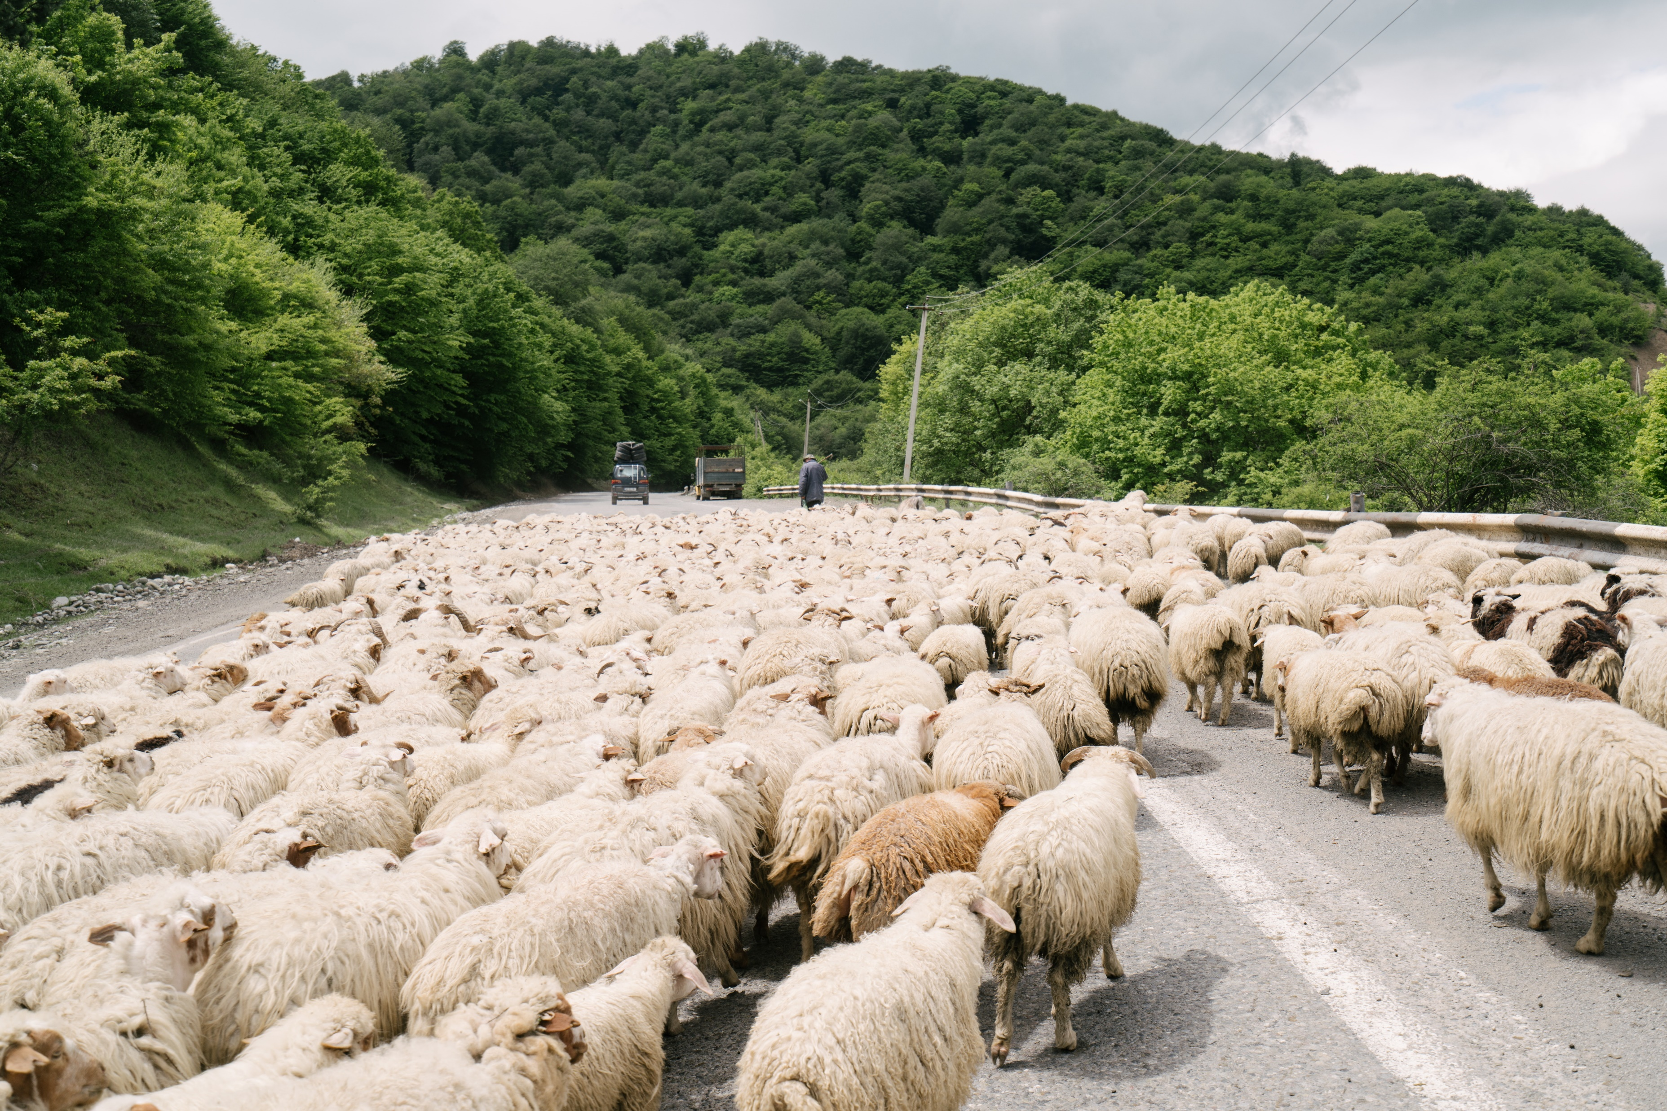
Namespaces
Group together what changes together
Notes:
Meaningfull names
Group by Features, Functionality
Avoid:
Bad namespaces(not meaningfull, does not add anything): Technical/Types
Enums
Intefaces
Helpers
ExtensionMethods
Mappers
Placing classes in the root
Will get a mess over time
Group together:
Group features together. You’re working on features
You’re not working on “Helpers”

Slide 9
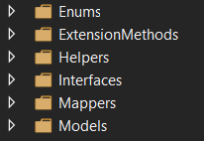
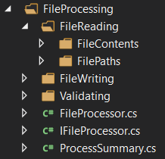
Notes:
Based on the demo application for processing files
Right side tells you what this application does
Easier to find the classes you need to change
Left side you need to change classes in all namespaces

Slide 10

External Dependencies
Notes:
Your application will have/You will always have external dependencies
That’s okay
You can’t/shouldn’t write everything yourself
Create an abstraction
Put them behind an interface with intention revealing name
More managable with updates
Isolated on one place
Not living in your entire codebase
Changes to external libraries wont break your entire codebase
Testable
-- own classes
-- you don’t want to test external deps

Slide 11
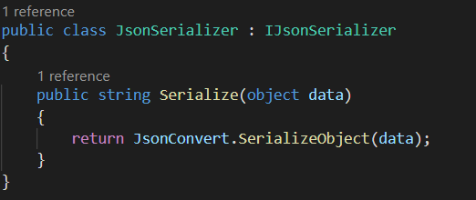
Notes:
NewtonSoft json
Wrapper around the serializer

Slide 12

Don’t be afraid to throw exceptions
Notes:
And when you are writing the logic for your classes
Don’t be afraid to throw exceptions
Don’t handle what you can’t handle
Application gets into invalid state -> throw exception
Guards -> invalid arguments -> throw exception
Throw exceptions in stead of returning null

Slide 13
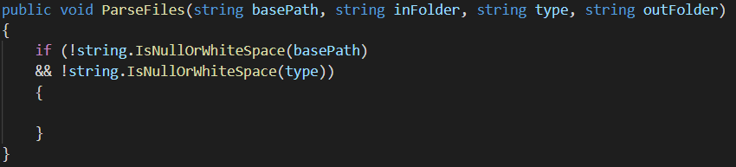
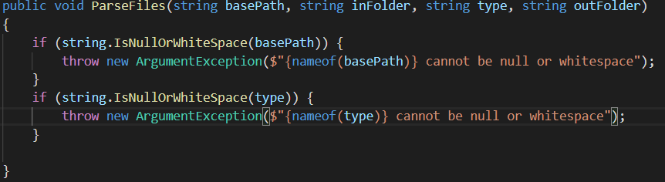
Notes:
The first class conitnues without doing anything when an invalid argument is provided
The second class throws an exception and this exception needs to handled on the right level
This can be done easier and I’ll show that in the demo

Slide 14

Richer Models
There is more than
primitives & DTOs
Responsibilities
Notes:
Move away from primitive types
Easier mistakes with arguments (compiler will accept mixing up strings)
Extra chance to give intention with names of classes and props
Bundle data together
FullName -> First name & last name
Give models the responsibility of keeping their data valid
Always in valid state
Use Methods to only expose the necessary
Immutable

Slide 15
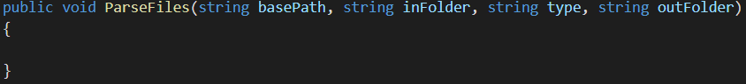

Slide 16

Logging
Not only
exceptions
Trail
Log level
Notes:
At one point you’re code will go into production
Do yourself a favour and give yourself a starting point when bugs happen
Don’t only log exceptions,
Craete log entry for every decisions in your app
Create a log trail/flow
Use separate log levels so you’re not flooding the log
Arguments
Decisions if statements
Or use a tool which can getter context information

Slide 17

Refactoring
When? Boy scout rule
Be transparent about it
Don't overdo it
Notes:
So sometimes your stuck with a legacy application with a lot of code smells
No worries. You can start improving without having to redo everything
When?
Now!
Boyscout:
Leave the campside cleaner than you found it. Clean up all files you touch improve the code quality to the desired level. You are already changing that feature so it already has to be tested
This will increase the code quality of your entire application over time.
You cannot sell to your customers that you need a couple of more sprints when it all works
Tell the customer when it takes more time because of refactoring
Tell them why it is important and that it will save them money in the long run:
Less bugs
Easier to change
Don’t overdo it
Dont refactor the entire application at once
Keep an eye on the delivering value. Be pragmatic

Slide 18

Unit Testing
Validating refactoring
Understanding the code
Notes:
Refactor code that you havent written, create unit tests
It’s a good way to understand the code before making changes if you’re not familiair with it
TDD – Writing afterwards feels more useless
Running unit tests is way faster than starting the application to see if it works

Slide 19

Team effort
Notes:
Pair programming
Work together on a feature
Push each others level up
Talking about a solution will most of the time improve the quality of the solution
Pull Request Reviews
Comments is not a bad thing, helps improve the developer and quality of the code base
Keep comments positive, not bashing colleques
Not only developers
Testers
Managers, have to understand good code costs time but will also save money in the long run

Slide 20

Demo
Notes:
Demo/show you tips in practice with some live coding
Code of one of my former projects
It has a lot of code smells and I want to apply these tips to make it more readable and maintainable

